Slide 1
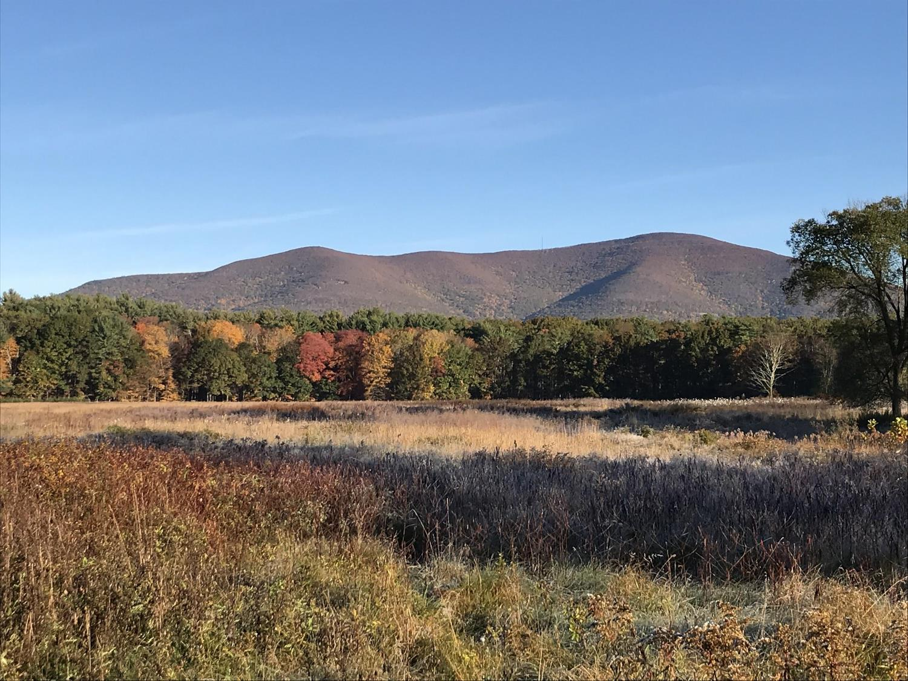
Catskill Science Collaborative
A unique partnership for research, resource management,
and outreach
Jamie Deppen and Gary Lovett
Cary Institute of Ecosystem Studies

Slide 2
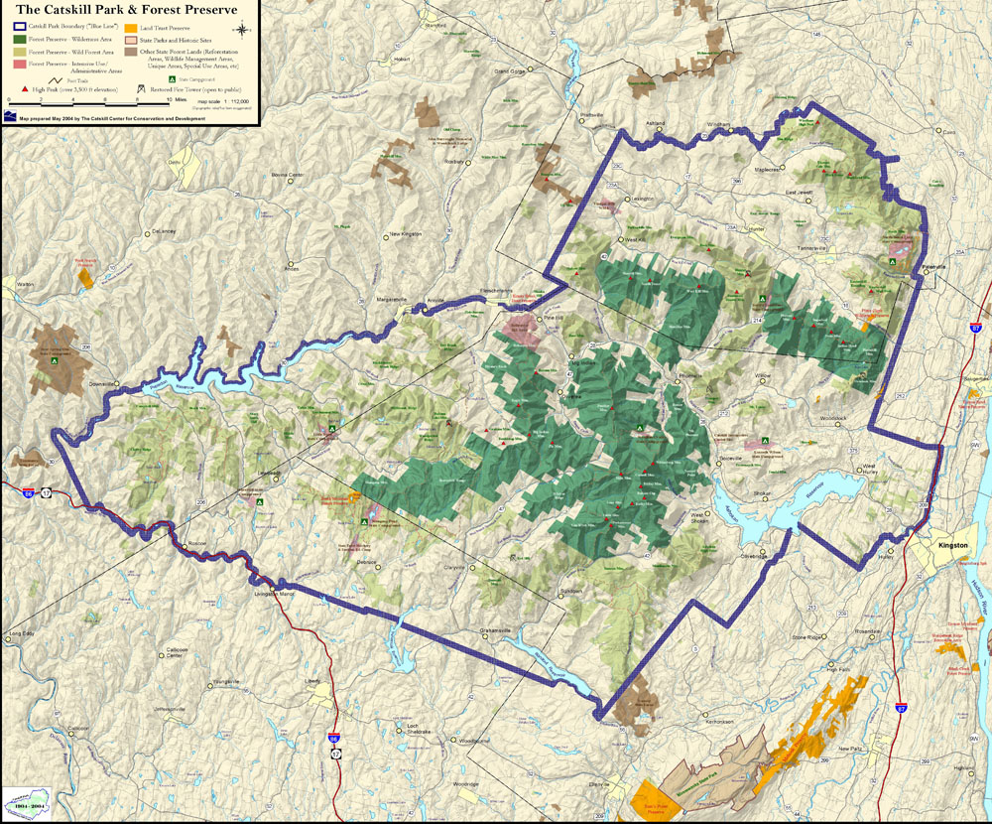
Catskill Center for Conservation and Development
Notes:
About the Catskill MountainsLets first ttalk about the Catskill Mountains of New York State
For those who are not very familiar with the area, the Catskills are between the Adirondacks and New York City. To Orient you here is Kingston, Pennsylvania, Albany
Blue line designates the boundaries of the Catskill Parkand is about ~50 miles west to east
The Catskill Science Collaborative works in the Greater Catskill Region, including the Catskill Park
the dark and light green blocks designate Catskill Forest Preserve.
New york City manages a number of reservoirs in the Catskills which Nine million people get their drinking water from. The water is transported through aqueducts down to the city.
Tourism, forestry, and agriculture are major industries in the Catskills and they require healthy and well-managed ecosystems for their long-term sustainability.
Point out reservoirs

Slide 3
Catskill Natural Resource Managers and Researchers
New York City Department of Environmental Protection
New York State DEC
NYSERDA
USGS
NY State Museum
4 Cornell Cooperative Extensions
4 county soil and water conservation districts
Cary Institute
Catskill Center
Woodstock Land Conservancy
Catskill Mountainkeeper
Colleges and Universities
Notes:
There a large number of agencies and organizations doing research, monitoring, and natural resource management in the Catskills. Here is are examples of the types of groups working in the Catskills
For a long time there were few opportunities for scientists and managers to exchange information across agencies and institutions

Slide 4
Formation of Catskill Science Collaborative
Started November 2018
Funded through New York State Environmental Protection Fund through the NYS DEC
Why Cary?
Notes:
The Catskill Science Collaborative was formed in 2018 to meet these coordination and communication needs.
Funded through the New York State Environmental Protection Fund through a contract with NYS DEC and hosted by the Cary Institute of Ecosystem Studies.
Cary has a long history of research in the Catskills starting with Gary Lovett’s and Kathy Weather’s work on forests and pollution in the 80’s

Slide 5
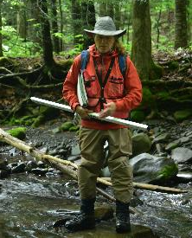
CSC Goals
Researchers
Natural Resource Managers
Public
Notes:
VOICE
The goal of the Catskill Science collaborative is to promote communication and collaboration among scientists, between scientists and natural resource managers, and between scientists and the public.

Slide 6
Data Portal
CERM Conference
Researchers
Develop scientific infrastructure
Notes:
We are working on developing the scientific infrastructure to help connect with researchers with each other we have been focusing on developing a data portal as well as helping to organize the Catskill Environmental Research and Monitoring conference

Slide 7
Catskill Data Portal: “One Stop Shop” for Catskill Data
Notes:
We have a data portal on FEMC’s data archive
And want to turn it into a “One stop shop for Catskill Data “
Currently have 19 projects available covering a number of subject areas

Slide 8
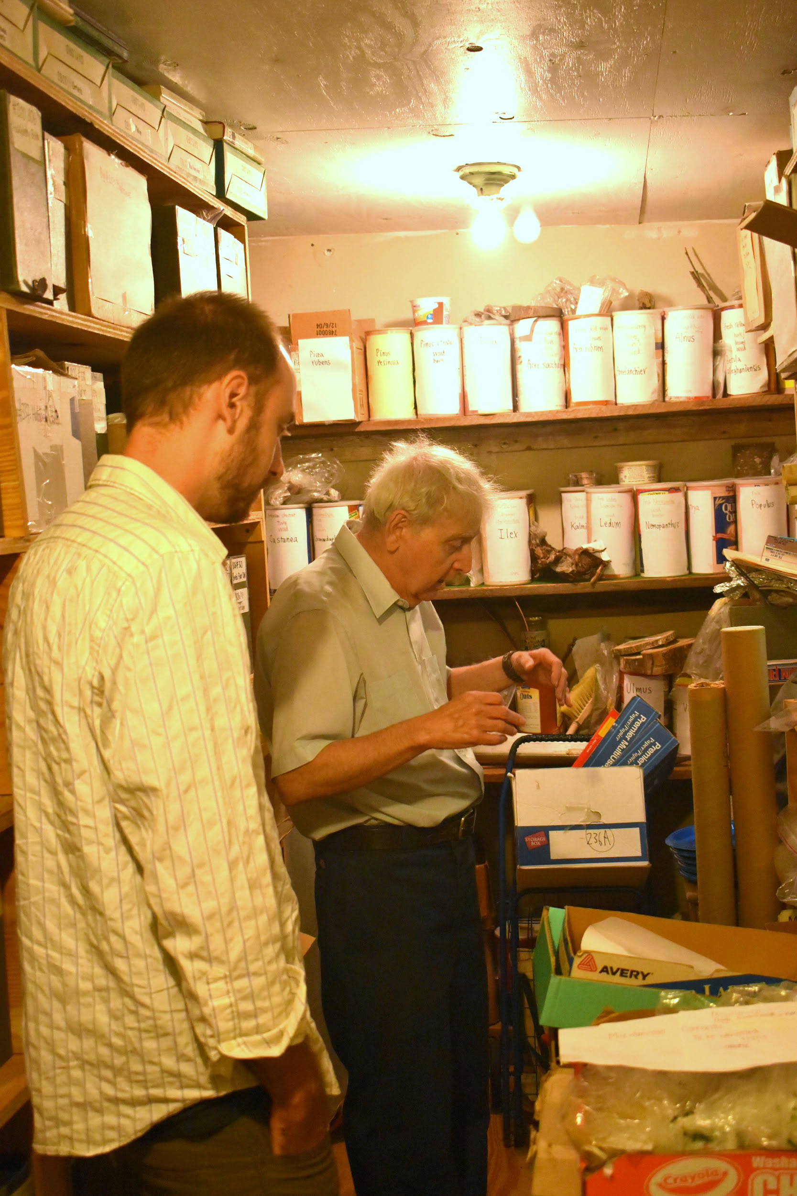
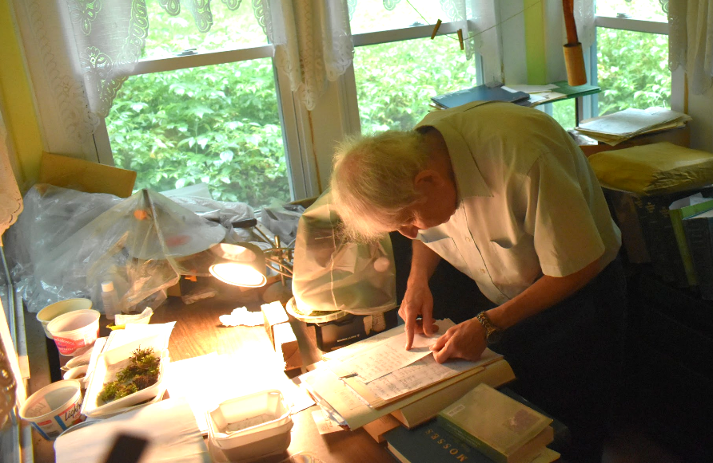
Michael Kudish Data Digitization
Notes:
A major focus for the data portal has been working to digitize Michael Kudish’s 50 year collection of hand-written field data. Michael is a field scientist who makes field trips to locations in Catskills specifically to interpret forest history such as by making vegetation observations or collecting bog peat core samples. He is a retired professor from Paul Smith’s College and he has converted his house into a research center of the Catskills. The Catskill Science Collaborative identified his collection as a priority for the Data portal. As we were looking for funding to digitize his project, we found out that FEMC had a Data Rescue program and Matthias came to Michael’s home for several days to scan files. Thank you Matthias and FEMC!

Slide 9
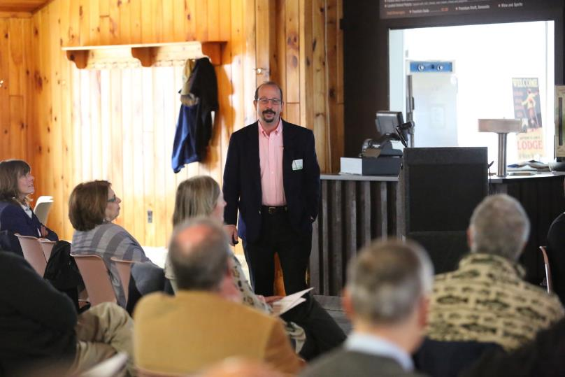
Catskill Environmental Reasearch & Monitoring (CERM) Conference
Notes:
Another way were are helping to connect researchers with each other is by helping to organize next years CERM conference
This conference is a collaborative effort by a number of organizations working in the Catskills
Biannual ac
We have had over a hundred people attend this conference each time it is held
Bring researchers together to share results
also attended by natural resource managers (transition)

Slide 10
Data Portal
CERM Conference
Catskill Research Fellowships
Researchers
Natural Resource Managers
Notes:
We are encouraging interactions between scientists and resource managers by funding Catskill Research Fellowships

Slide 11
Catskill Research Fellowships
Surveyed resource managers for research needs
Match professor and student expertise with research needs
Provided stipend to student fellows
Academic advisor and agency mentor
Notes:
Asked resource managers what they research needs they wanted help with
Fellowships are meant to match the expertise of professors and their students with the research needs of natural resource managers.
The student is provided a stipend and paired with an academic advisor and agency mentor

Slide 12
Catskill Research Fellowship Goals
Provide positive research experience for students
Promote scientifically informed resource management
Attract new researchers to the Catskills
Develop pipeline of researchers working in the Catskills
Notes:
Provide a positive research experience for student fellows where they are part of a collaboration
Promote that information exchange between researchers and resource managers to promote science informed resource management
Currently there is a lack of substantial funding for research in the Catskills, and a lack of researchers using the Catskills to help answer nation-wide or global questions. That gives them access to larger funding sources such as NSF. This funding for fellowships can help attract new researchers to the Catskills to address more local questions relevant to resource management
Bring students to the Catskills in the hope they will want to continue to study in the Catskills
2019 – 4 fellows, 2 of those funded by SCSWCD
Students are working on summarizing their work now and we will have results by the end of December.
We are currently accepting applications by professors due next Thursday for next year’s fellowships.

Slide 13
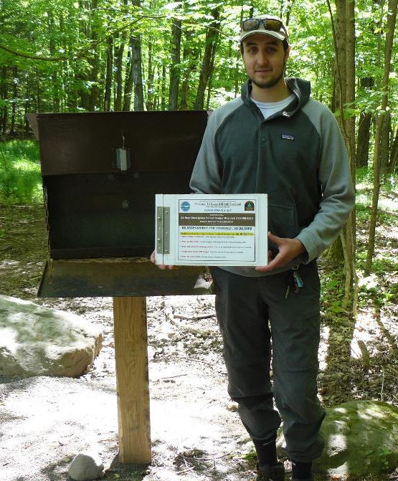
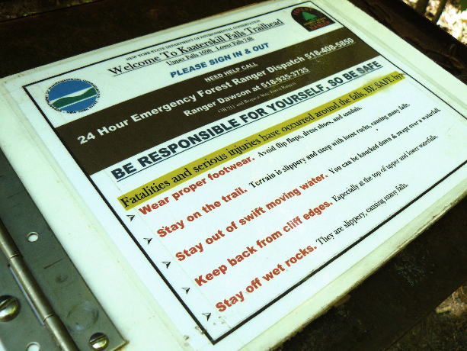
Perceptions of Trail Risk in the Catskill Park
Fellow: Matthew Borovy, SUNY ESF
Academic Advisor: Diane Kuehn
Agency Mentor: Pine Roehrs, NYSDEC
Notes:
VOICE
Our first fellow is Matthew Borovy and he studied the perception of trail risk in the Catskill park. New York State DEC had historical trail register data that is wasn’t sure how to interpret because they needed more data. They were interested in trail sign in rates and why people would or would not use the registry.
Matthew spent his summer sitting at trailheads surveying visitors and making observations on their preparedness for the trail and whether they signed in.
The Catskills are seeing a surge in recreational users. This has been wonderful for the Catskills Economy, but it is creating new challenges for resource managers who are seeing an Increase in users of trails.
Trail registers like the one Matthew is standing next to, help the department in the event of an emergency to help them locate someone, as well allocating other resources such as funding trail maintannece.
Who is using the trails, how, are they signing in, why not, locations of trail registers, signage, and other actions. Preparedness for the trail
This will help New York State Department of Environmental Conservation make decisions about resource allocation to manage the trails.

Slide 14
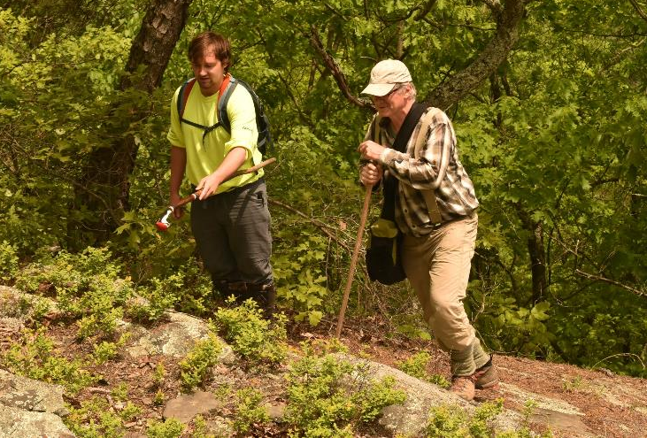
Recreational Use of Timber Rattlesnake Habitat in the Southern Catskills
Fellow: Alexander Jones, SUNY ESF
Academic Advisor: James Gibbs
Agency Mentor: Lisa Masi, NYSDEC
Photo: Lisa Masi
Notes:
Eastern Timber Rattlesnakes are a threatened species in New York. DEC wants to know what areas they use in the summer and to understand possible interactions with recreationists to keep recreationists and the rattlesnakes safe. Alex found that there were much more robust populations than DEC realized and DEC is already modifying it proposed trail locations. This is just an example of how important a role these fellows play for these resource managers.
Where are rattlesnakes? How do they need to modify plans for new trails? . They can have large home ranges and are susceptible to poaching and loss of habitat.

Slide 15
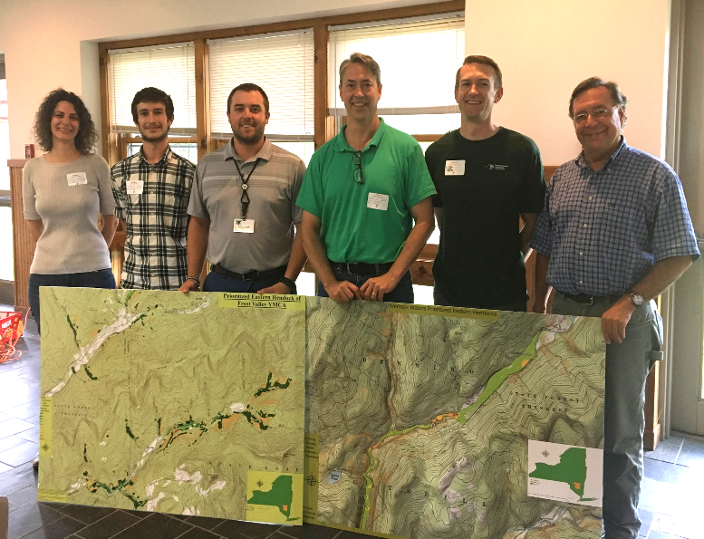
Working with Stakeholders to Protect Hemlocks for Water Quality and Recreation
Fellow: Ben Fairbairn,
Hobart and William Smith Colleges
Academic Advisor:
Kristen Brubaker
Agency Mentor: Karen Rauter,
Sullivan County and Soil and
Water Conservation District
Photo: Karen Rauter
Notes:
Ben worked with the the Sullivan County Soil and Water Conservation District and this agency gets funding from New York City DEP to manage streams in the New York City Watershed.
Ben worked with two very large private landowners in the City watershed that had a lot of stream property. He created GIS maps that prioritized where the landowners could use pesticides to protect hemlocks from the the invasive pest called hemlock woolly adelgid. When hemlocks on stream banks die from this pest, the banks become unstable and start eroding. The map identified where the landowners priorities and the agenicies priorities overlapped.
This picture was taken at a meeting where Ben presented his results. Important picture to Karen – represents a shift in the landowners’ willingness to learn and engage and determine next steps

Slide 16
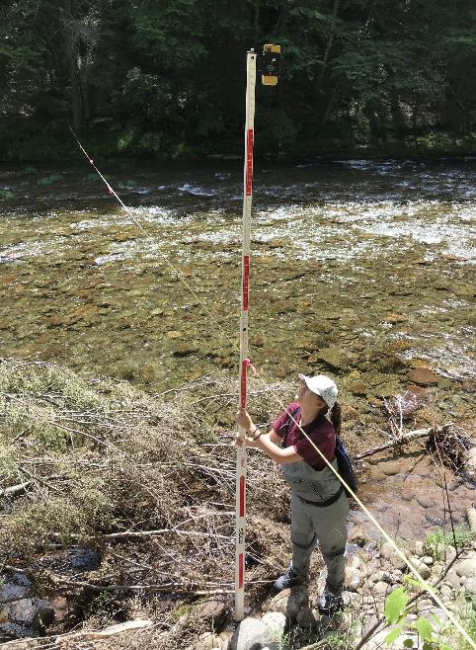
Improving Measurements of Stream Flow on the West Branch of the Neversink River.
Fellow: Julie Helthaler,
Rensselaer Polytechnic Institute
Academic Advisor: Victoria Bennett
Agency Mentor: Mark Vian, New York City DEP
Photo: Mark Vian
Notes:
Stream design is important to restoring riparian areas prone to erosion and after flood events. DEP uses an equation to help make stream design decisions and Julie is collected measurements specific to Catskill streams to help improve stream design recommendations.

Slide 17
Data Portal
CERM Conference
Catskill Research Fellowships
Researchers
Events
Natural Resource Managers
Public
Notes:
The CSC also coordinates public events highlighting science in the region – Science in the Catskills Series

Slide 18
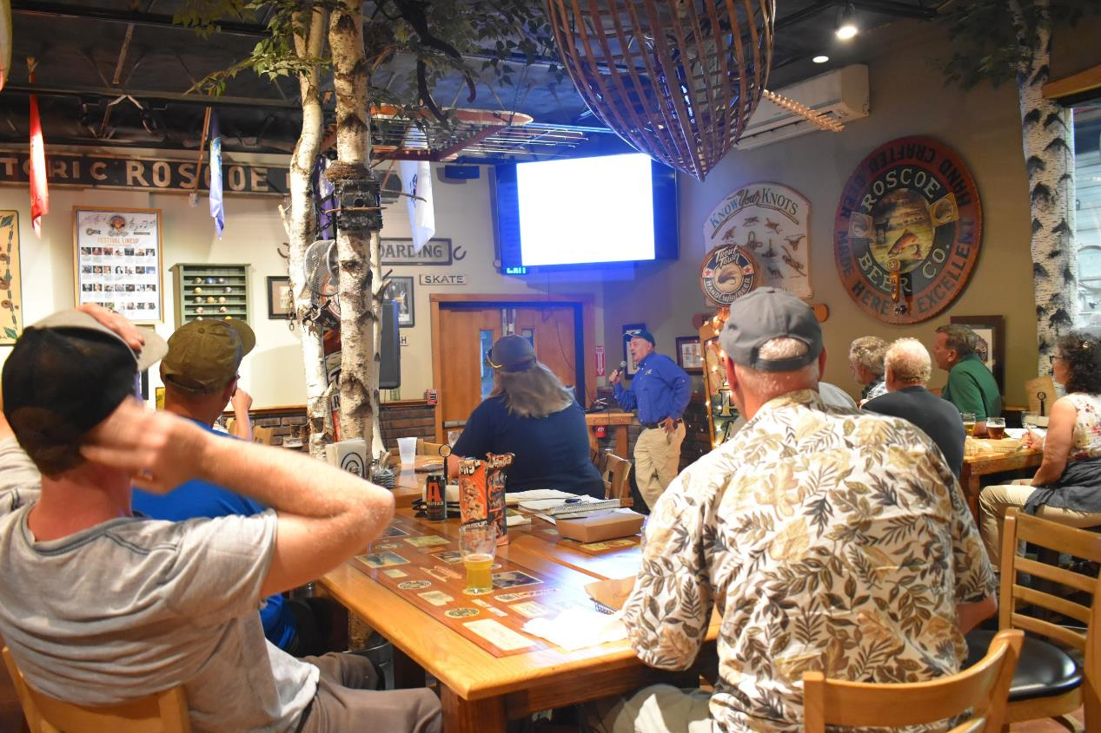
Fish Science Pub Night
Notes:
VOICE
This years events included a fish science pub night where USGS biologists talked about their work in Catskill streams….
We held a fish science pub science night in Roscoe that was very successful. Roscoe is famous for its fishing because it is located at the confluence of the Beaverkill and Willowemoc which creates great conditions for trout fishing. Roscoe Beer Company had a fun vibe and was willing to work with us. Barry Baldigo and Scott George presented their work on the fish popolulations and water quality in catskill streams. Purposefully targeted angler audience. 25 people

Slide 19
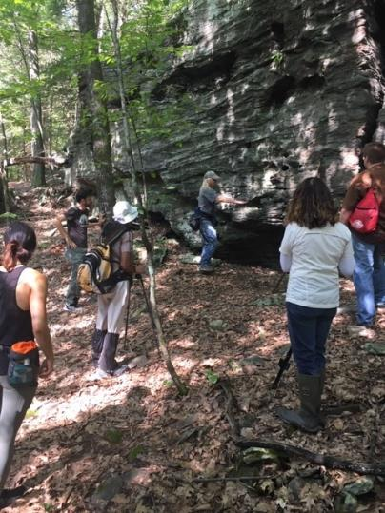
Photo: Gary Lovett
Rock Science in the Catskills
Notes:
…..a geology walk led by the New York State Geologist….
We did a Geology walk in partnership with the Woodstock Land Conservancy at Sloan Gorge Preserve. and Chuck Ver Straeten a geologists with the New York State Museum with a special insterest in sedimentary geology and porcupines led the walk. Very popular – filled up a month prior to walk, with waiting list, questionable weather led to poor turn out – 7 people

Slide 20
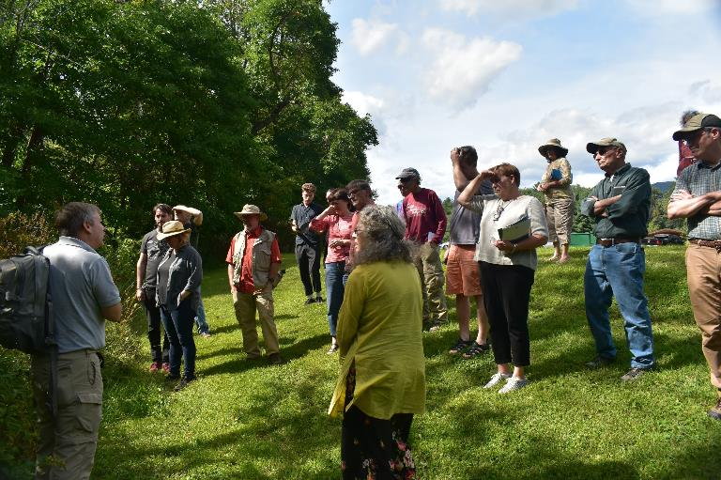
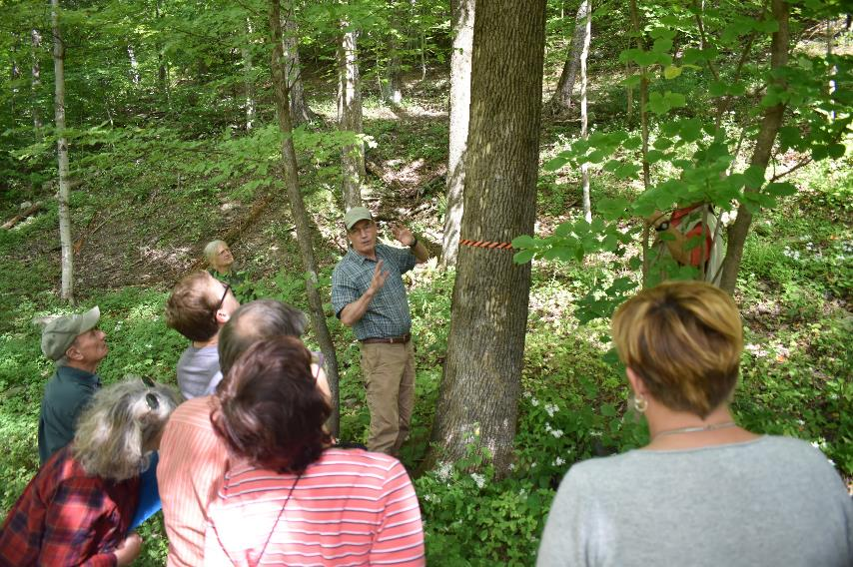
Alien Invaders Strike the Catskills
Notes:
….and an invasive species workshop.
Invasive species lecture and walk in partnership with the Catskill Center- Held at the Catskill Visitor Center which is meant to serve as the gateway to the Catskills. That is a good place to stop for your first visit to the Catskills. very successful 25 people

Slide 21
Lessons Learned
Data Portal
Difficult to get scientists to upload existing datasets onto portal
Fellowships
Need to improve communication between manager, professor, fellows and CSC
Social science research needed in the Catskills for understanding use of resources
Notes:
VOICE
Difficult to get people to upload existing datasets onto portal because they need to prepare data for publishing online and get it formatted.
Need to improve communication between manager, researcher, fellows and CSC
Consider remote area with little wifi and cell coverage,
Social science rese important for understanding use of resources and effectiveness of science outreach
Don’t want to compete with other programs, working on identifying unmet need
People are willing to travel from NYC, putnam, and Dutchess counties, Pennsylvania to events in the Catskills, even Western Catskills
For question on social science: what types of

Slide 22
Lessons Learned
Events
Don’t want to compete with other Catskills programs for public outreach
People are willing to travel from NYC, Putnam, and Dutchess counties, Pennsylvania to events in the Catskills, even Western Catskills
Notes:
We had a man travel from Putnam County to Roscoe for the Pub science night, over a 2 hour drive, who heard about it on the Cary website

Slide 23
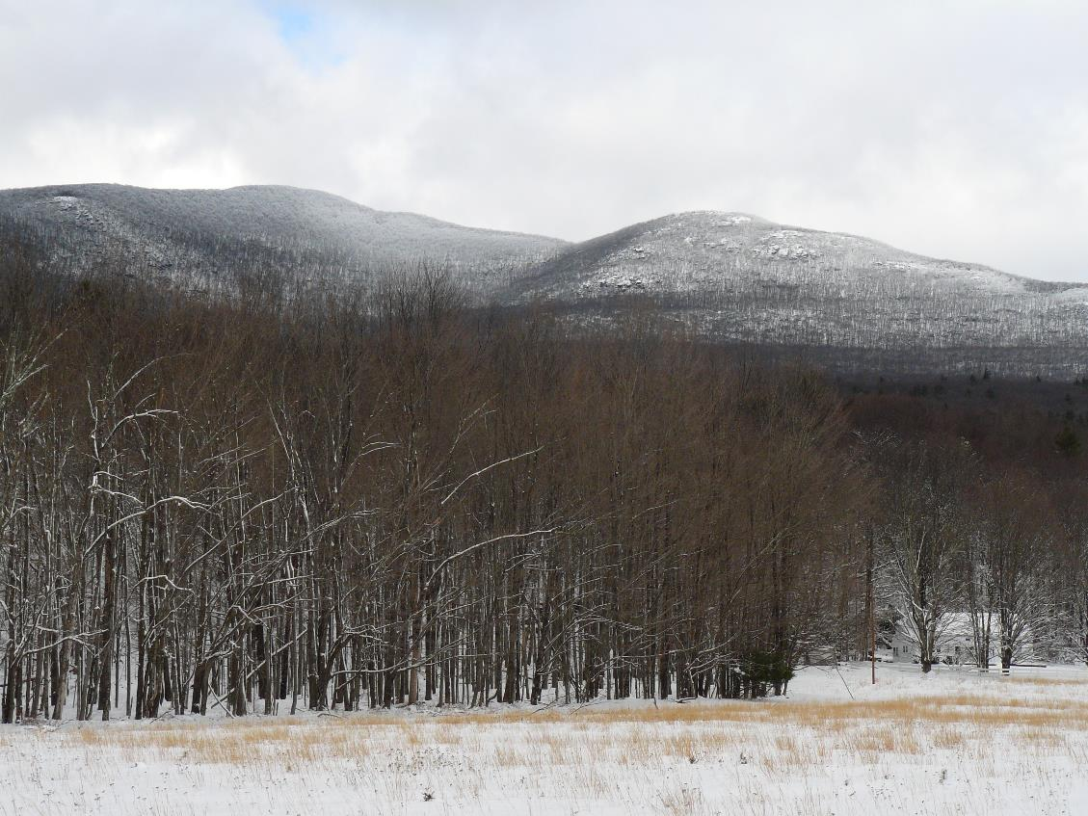
Questions?
Photo: John Thompson
Notes:
Academics, Demographics, psychology – behavior change

Slide 24
Extras

Slide 25
A vibrant and active Catskills research community…
How do you create this?
What are the current limiting factors?
Field housing
Funding
Central research location/site
We don’t have a “College of the Catskills”
Complex dynamics of agencies and their funding mechanisms
Notes:
Identifying ways to further reach a goal of a vibrant and active research community
People who do environmental work in the Catskills like to compare and constrast the Catskills with the Adirondacks. The Adirondacks have a higher profile and have a lot more research and recienve more political attention
We don’t have a a college or university that is claiming the Catskills
Takes a lot of effort for researchers to figure out dynamics.

